Slide 1

DJJJ Presents
BSA
Book Store Application
Dawson, Brown
Judah, Csanyi
Joshua, Leslie
Jeremy, Paruch

Slide 2
Why this project?

Slide 3
Disclaimer*
Some Slides Contain Outdated Code The final product exists on DJJJ’s Github
It still works!

Slide 4
Meet
The
Team

Slide 5

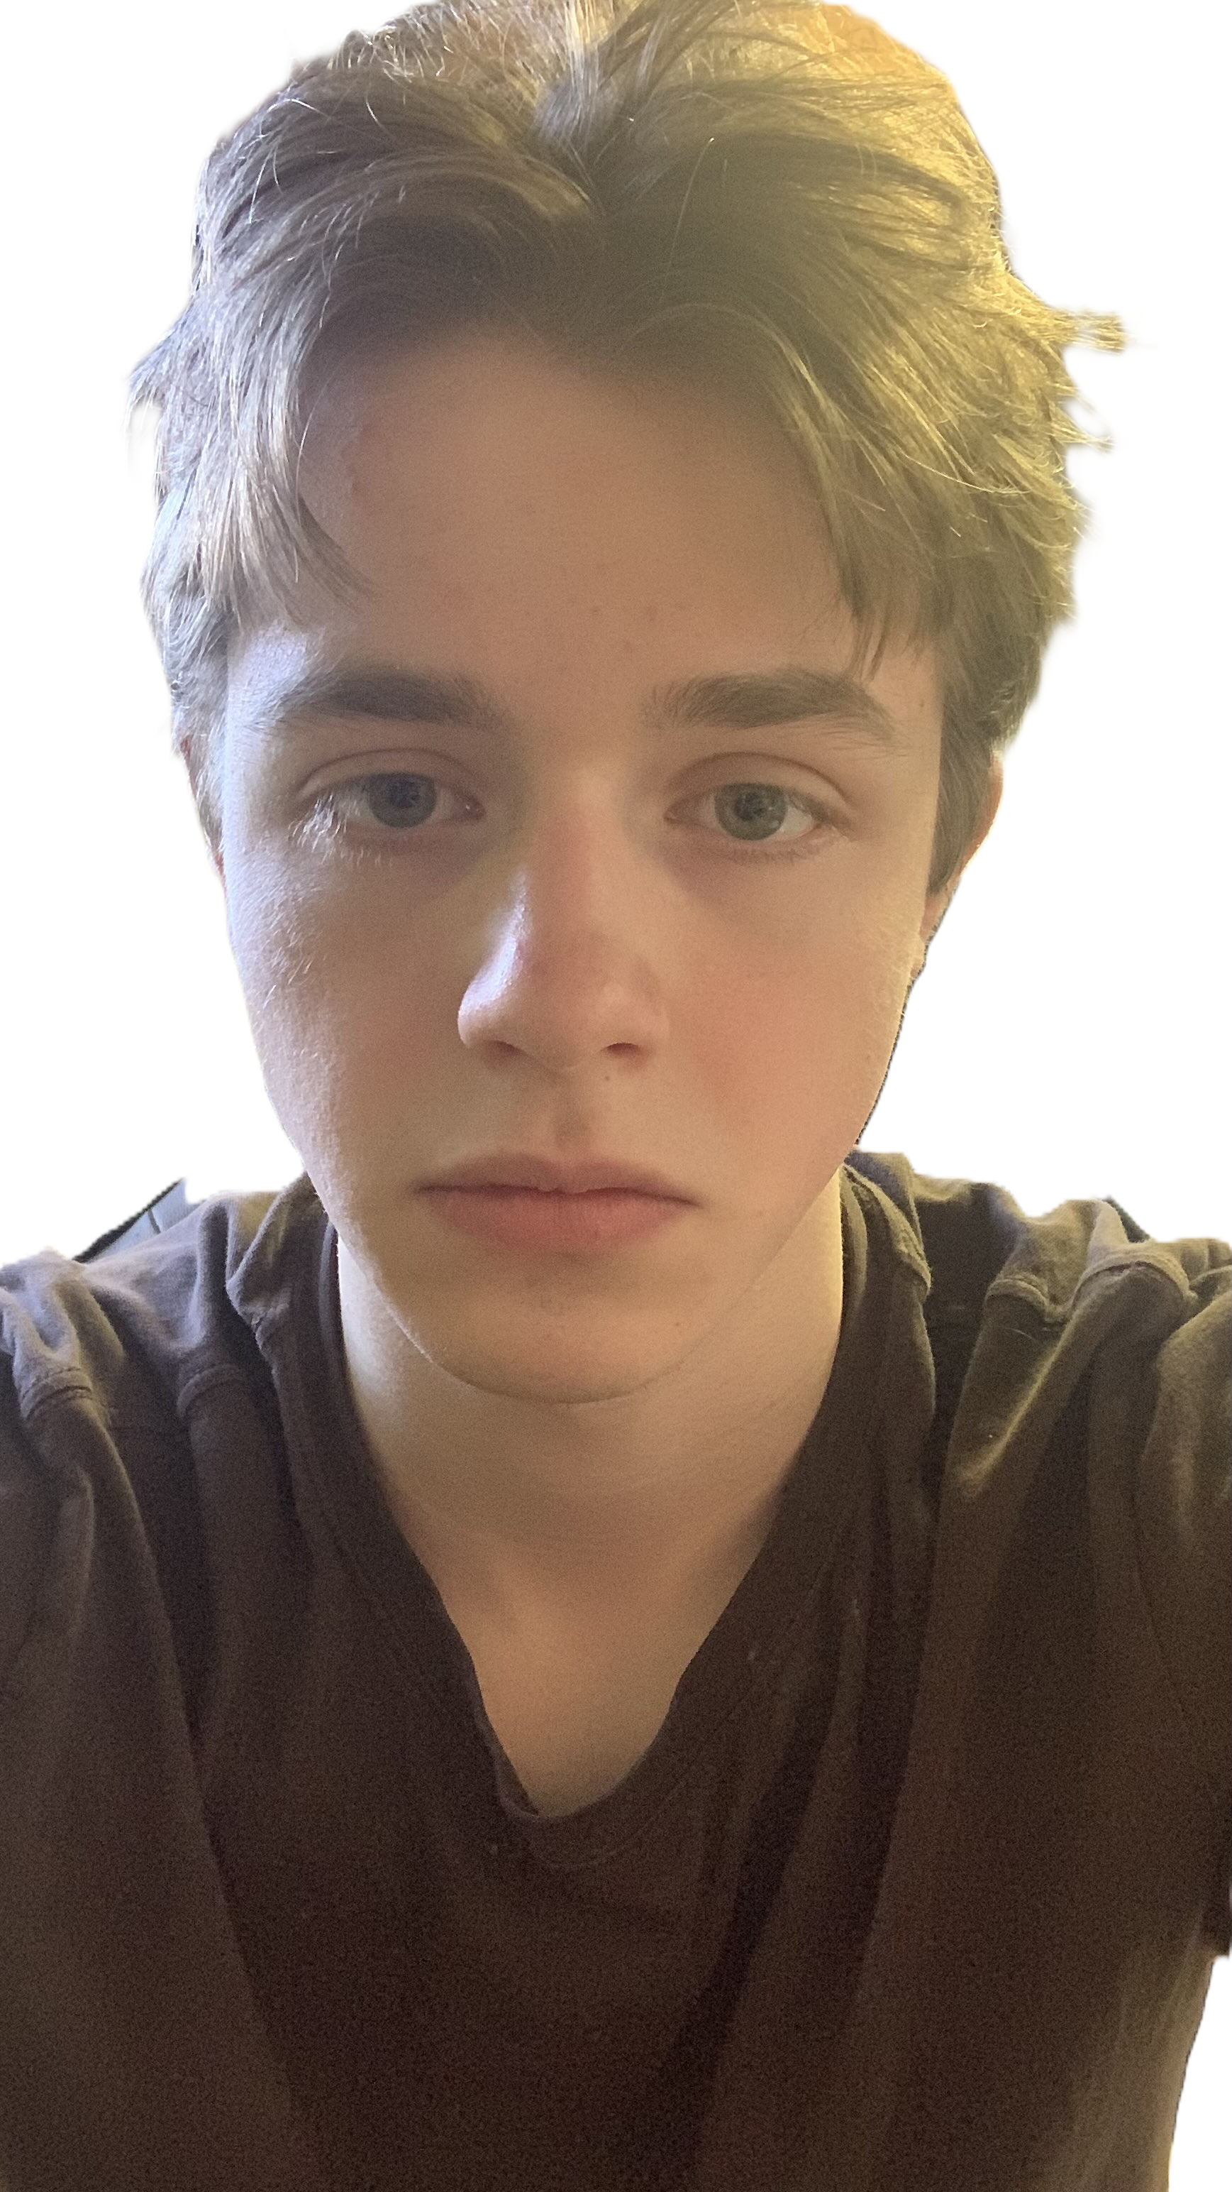


Meet
The
Team
Primary: Testing & Document- Main Speaker
Primary: Back End Developer
Primary: Back End Developer
Primary: UI and Integration Specialist
Dawson Brown
Judah Csanyi
Joshua Leslie
Jeremy Paruch
Secondary: Speaker
Secondary: Bug Catcher
Secondary: Back-end Developer
Secondary: Back-end Developer

Slide 6











Main Menu

Slide 7




LogIn
User Login

Slide 8
1

Slide 9
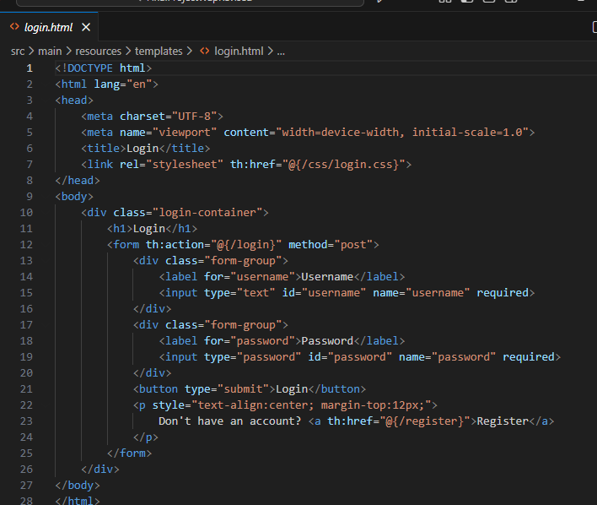
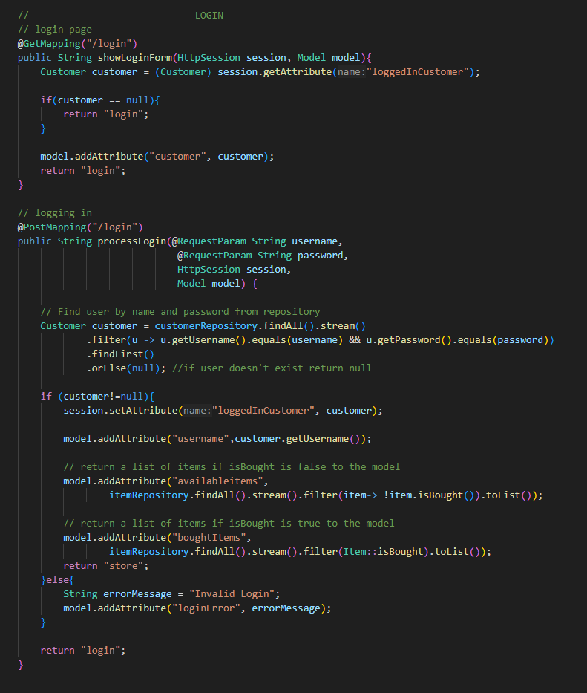
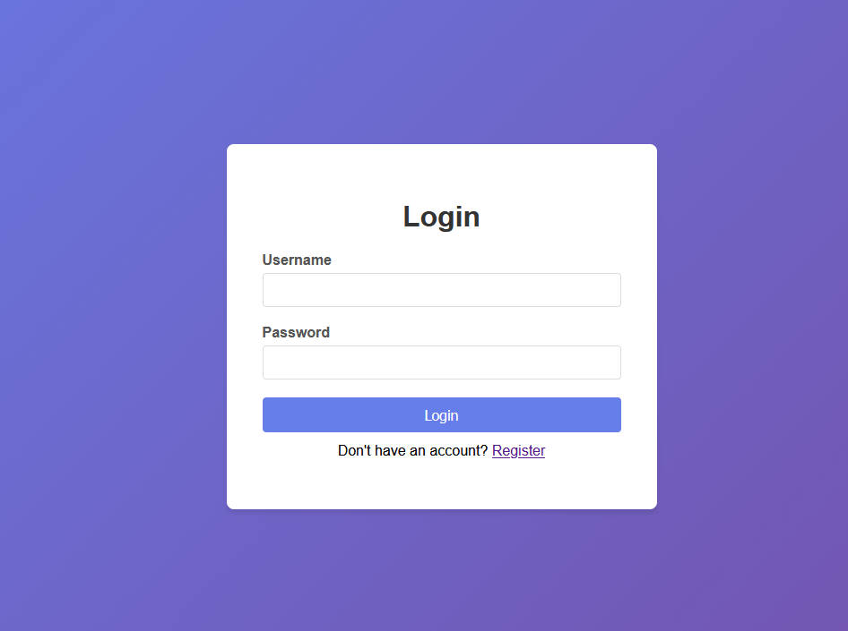
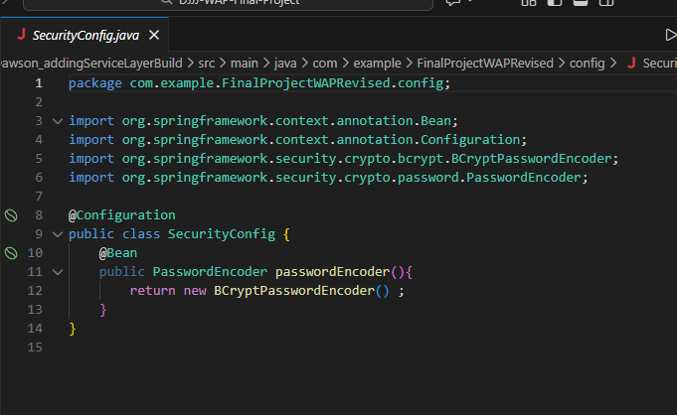
Login
1

Slide 10
2

Slide 11
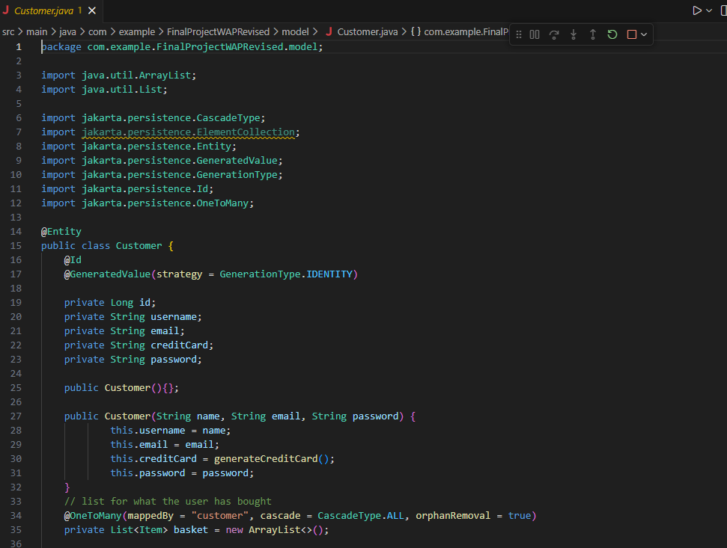
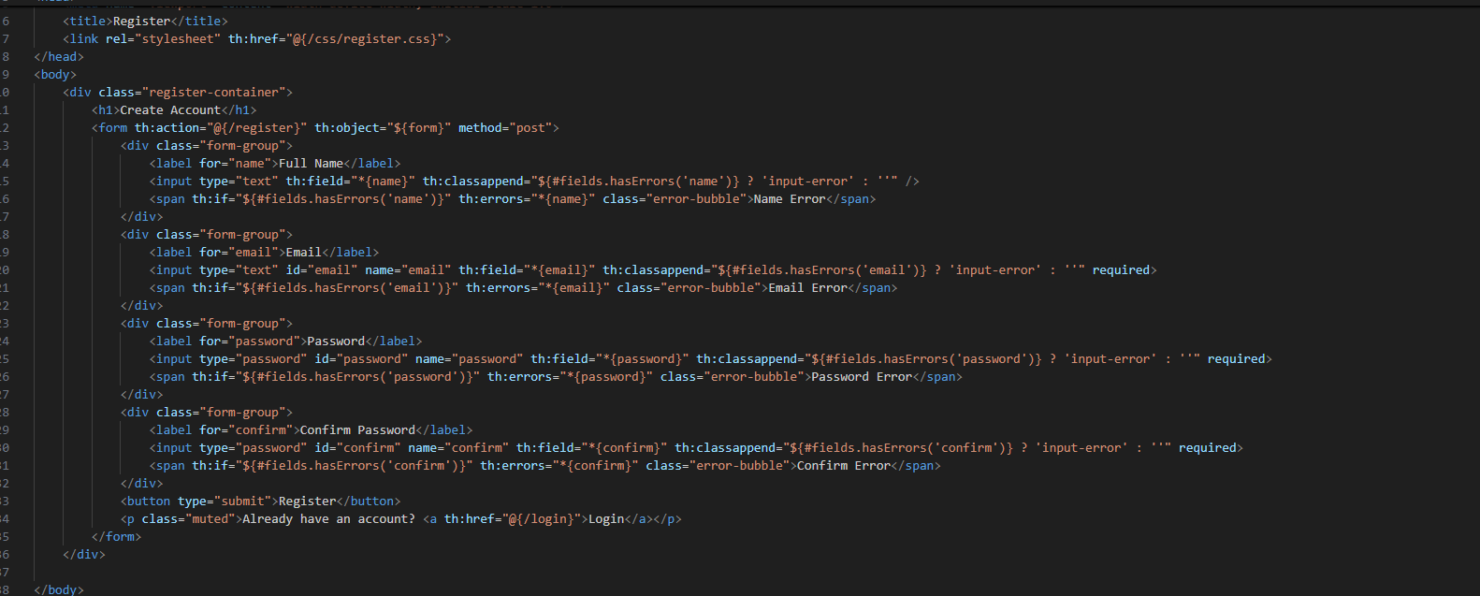
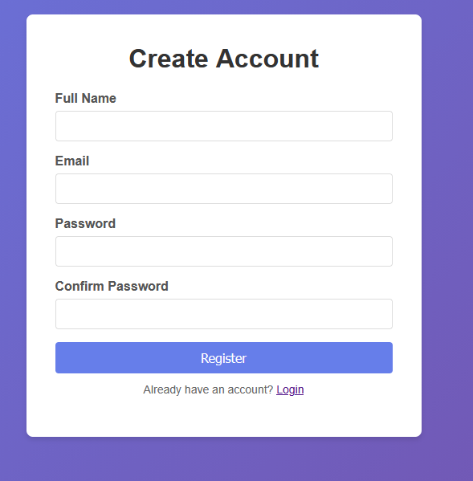
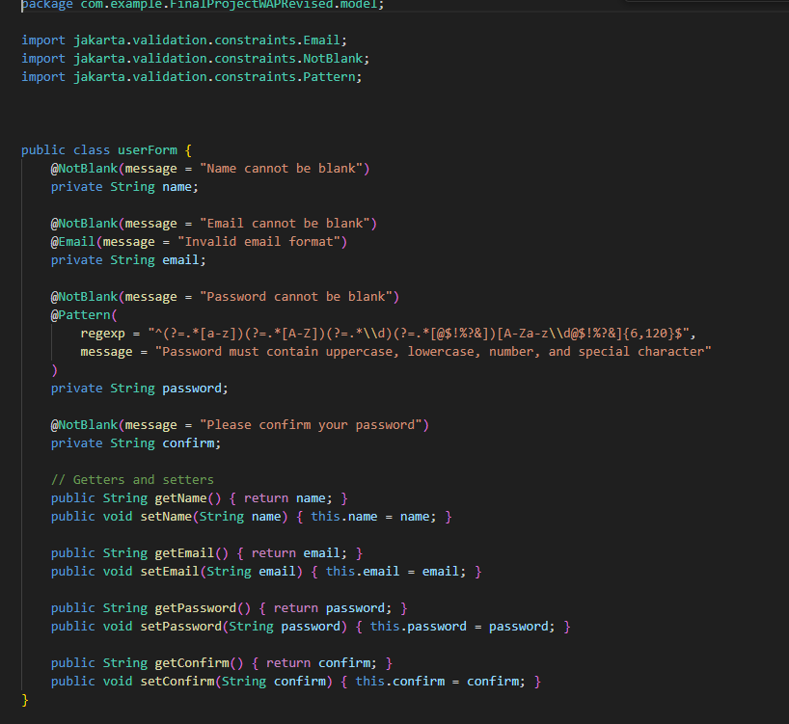
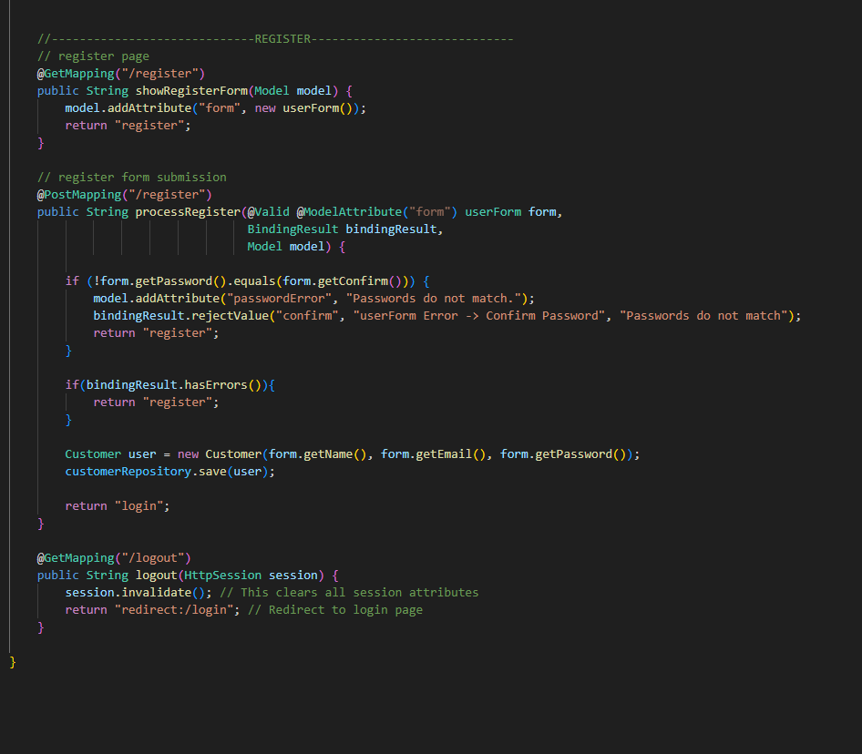
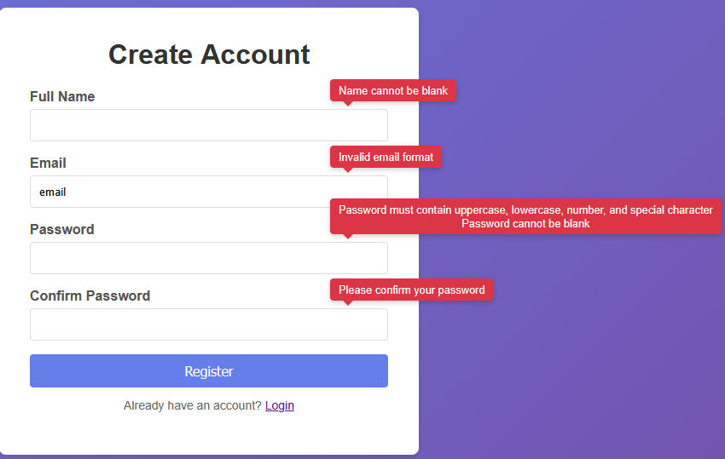
Register
2

Slide 12

Store
Store

Slide 13
1

Slide 14
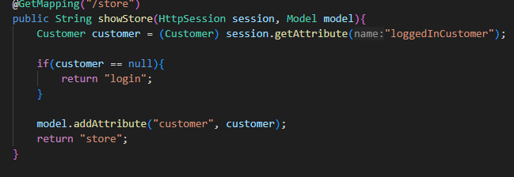
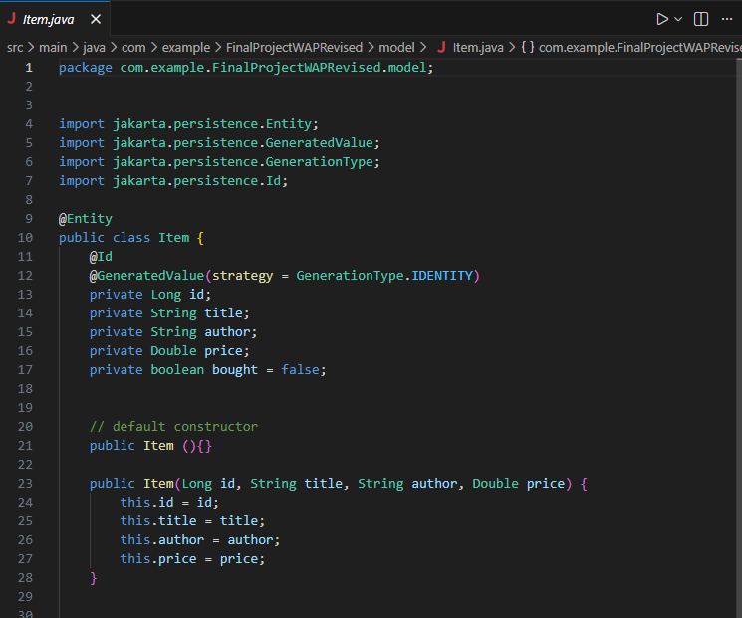
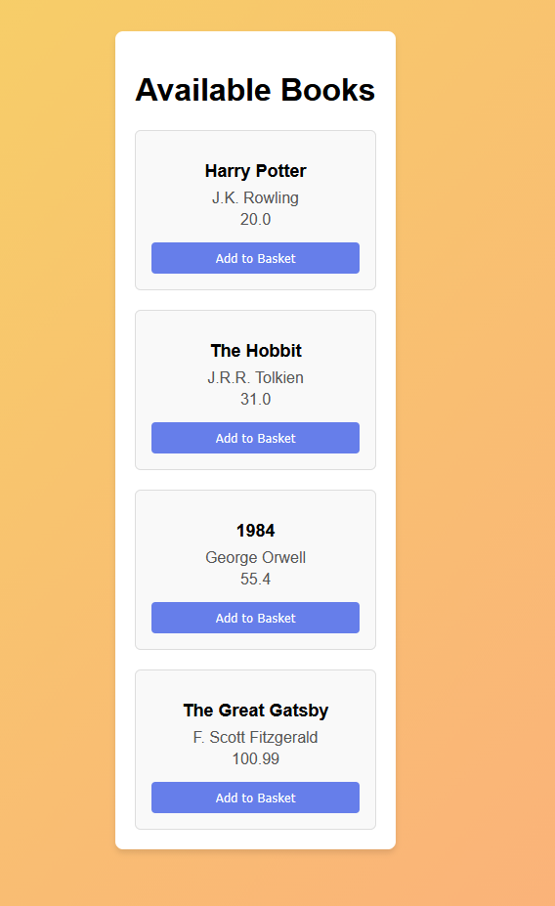
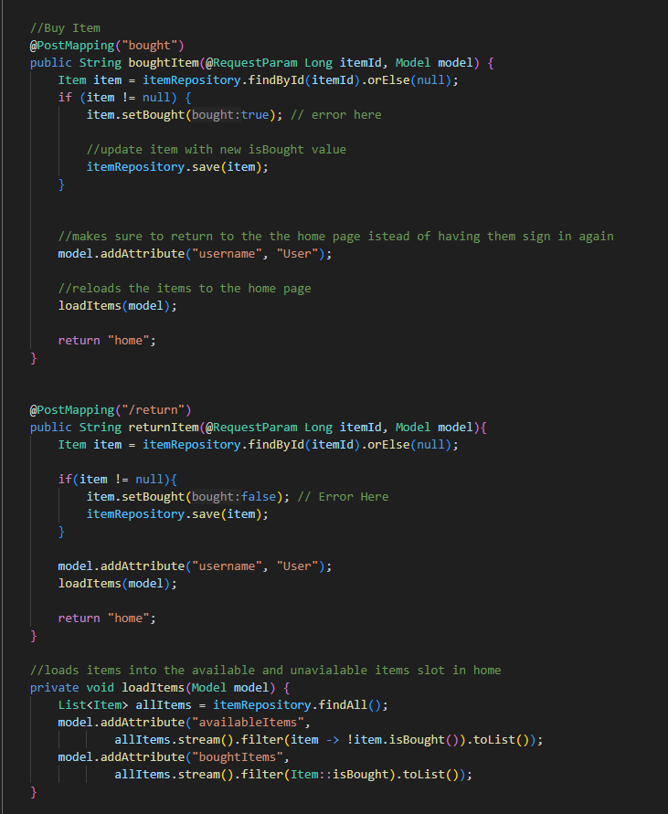
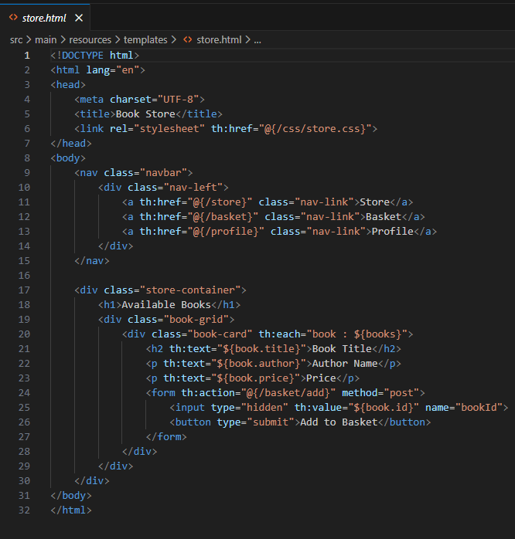
The Inventory
1

Slide 15

User Profile
User Profile

Slide 16
1

Slide 17
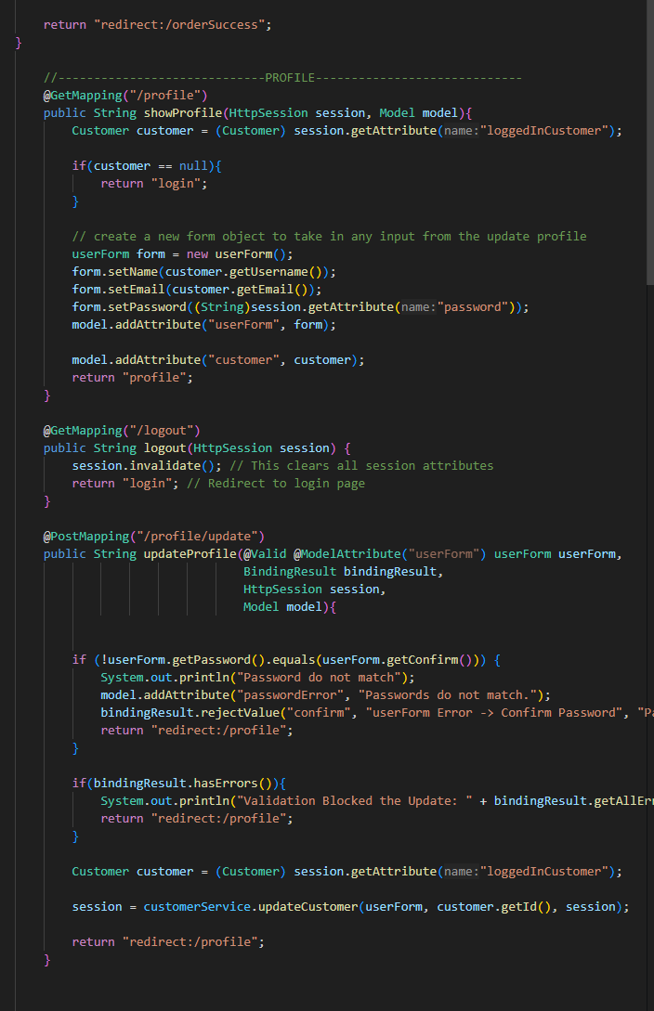
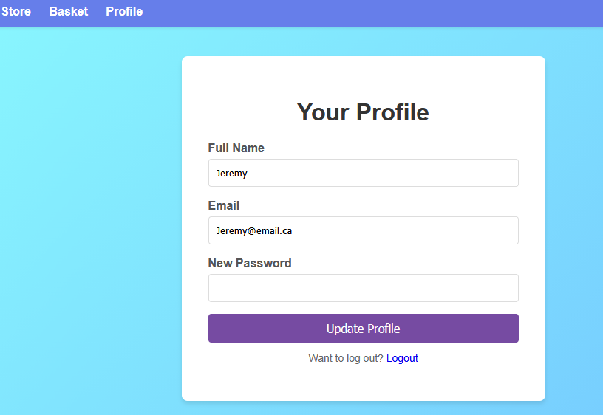
User Profile
1

Slide 18



Basket
Basket

Slide 19
1

Slide 20
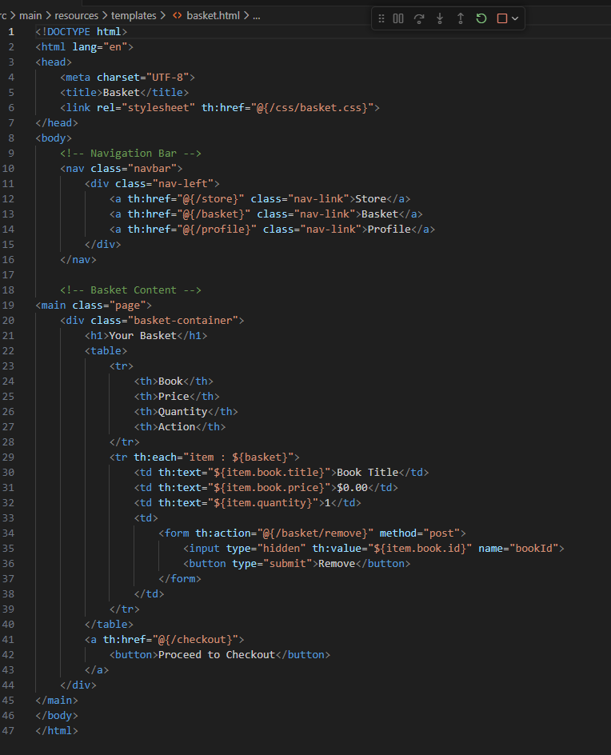
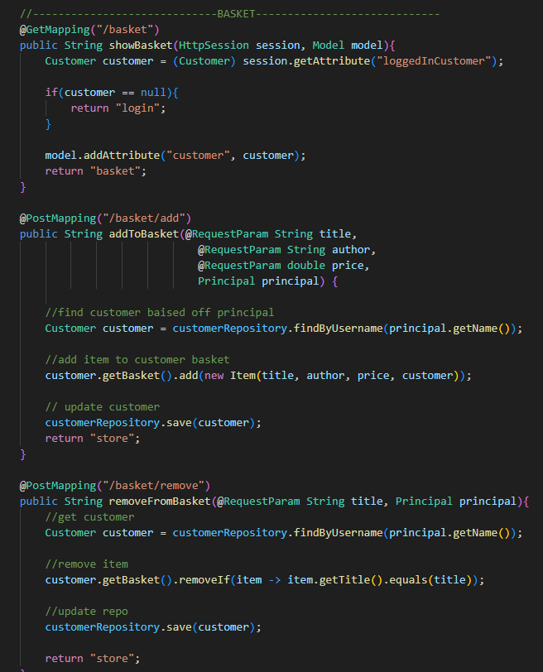
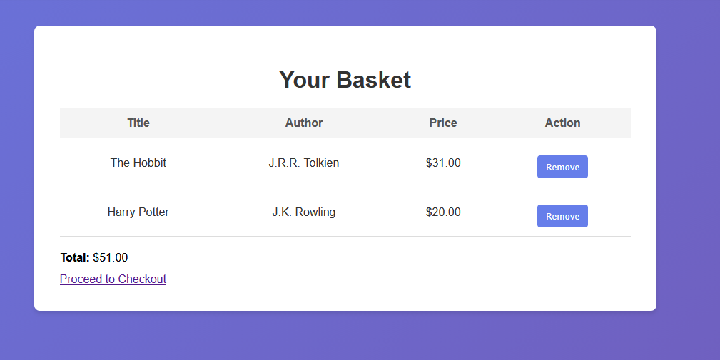
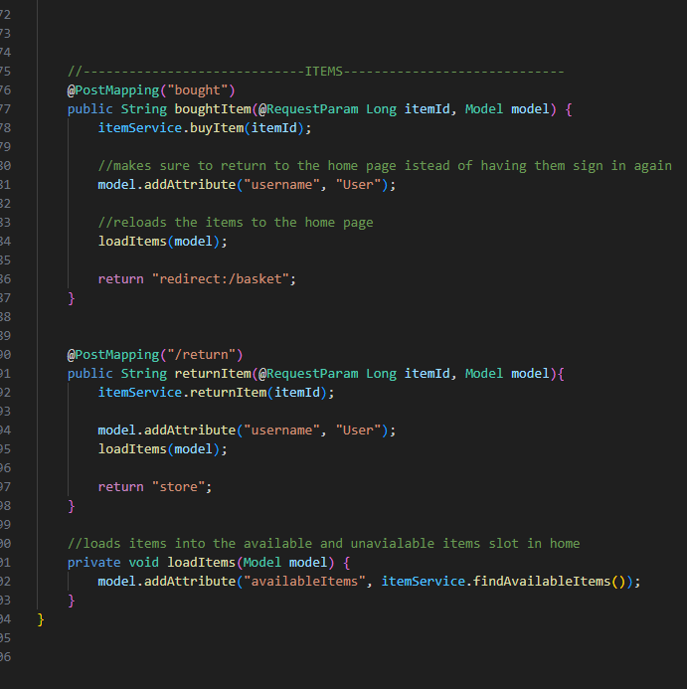
Items
1

Slide 21
2

Slide 22
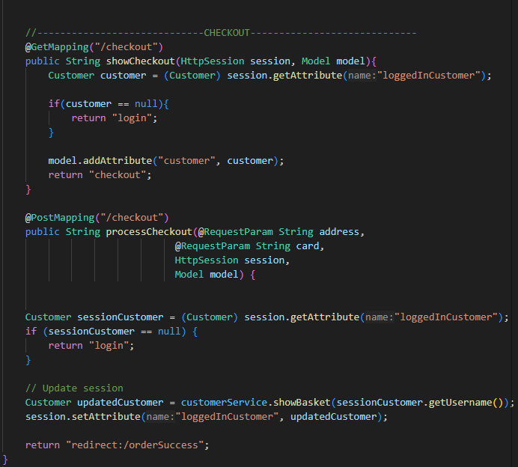
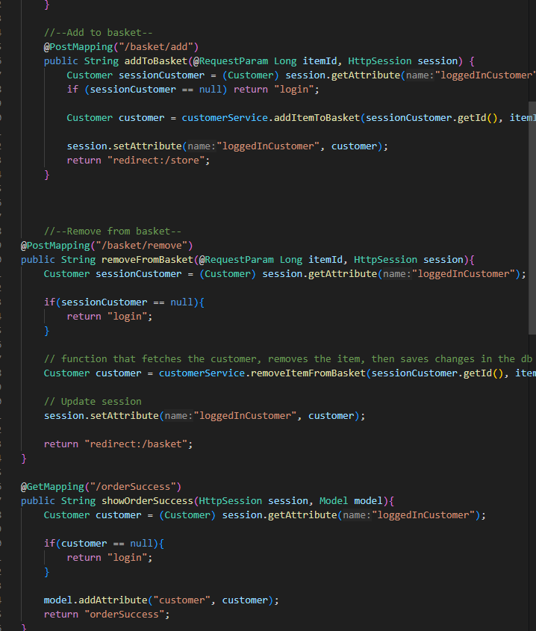
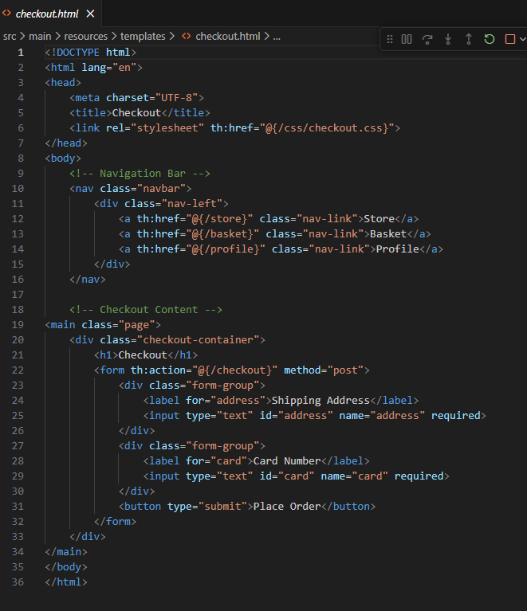
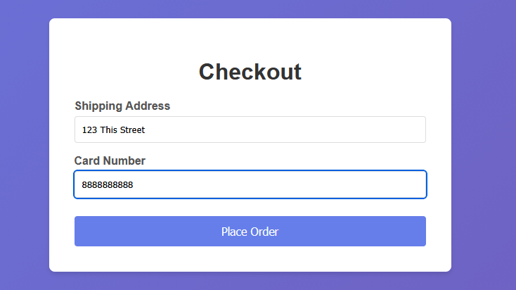
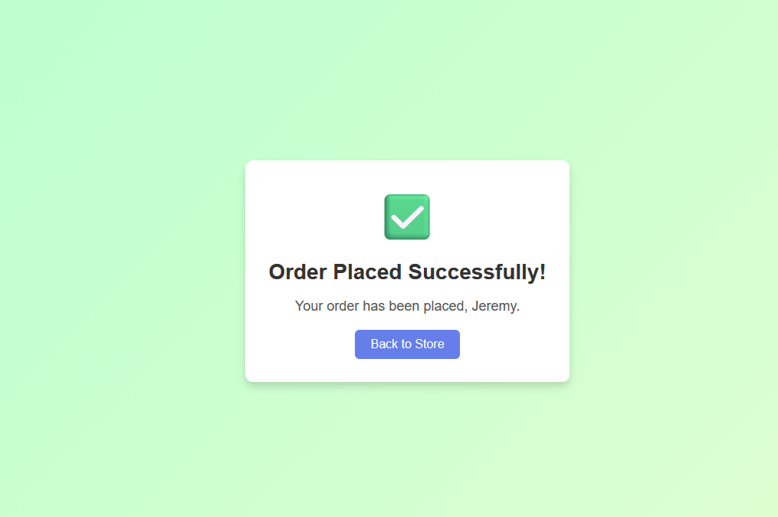
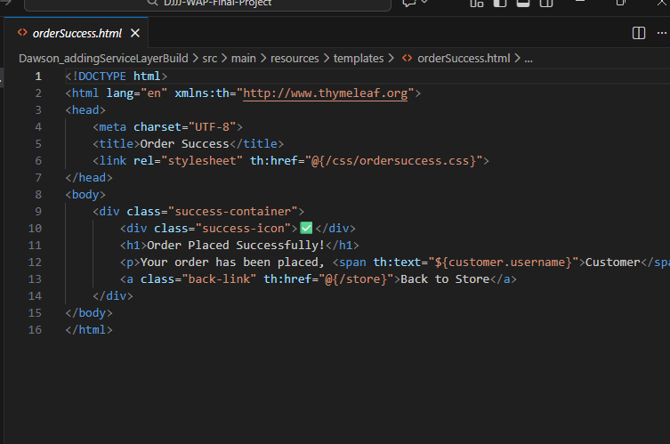
Checkout
2

Slide 23



Diagrams
Diagrams

Slide 24
1

Slide 25
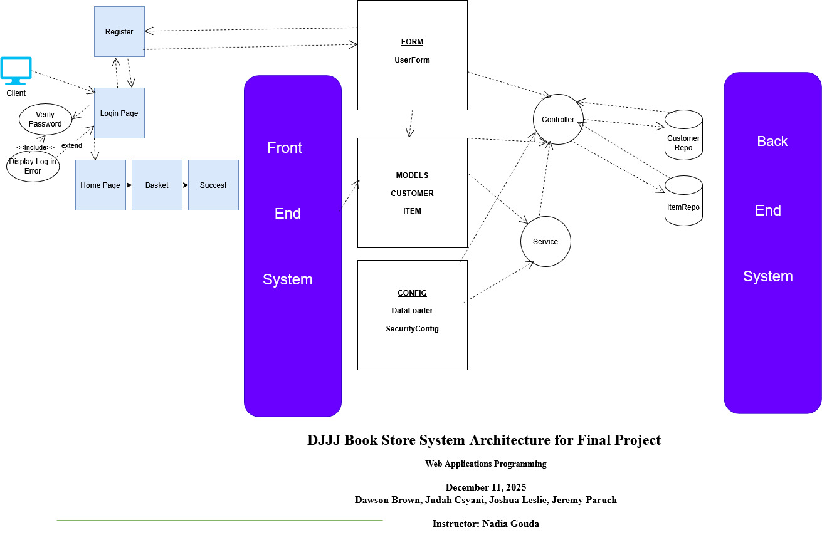
Diagram Architecture
1

Slide 26
2

Slide 27
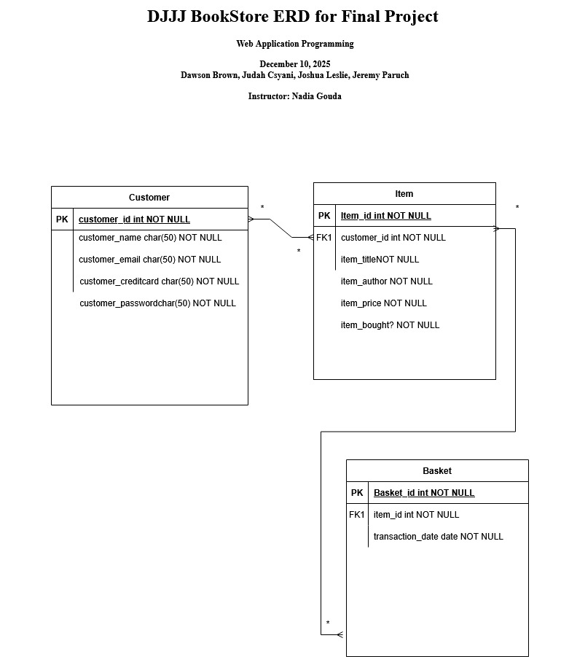
Diagram Architecture
1

Slide 28

LIVE DEMO
Live Demo!

Slide 29

Why Us?
Why us?

Slide 30
1

Slide 31
Efficiency
1
We know everything already
Nothing is secret
Nothing is Safe
Delicious Credit Credentials >:)
We are efficient
Everything Is secure
Peace of mind

Slide 32

Closing Remarks
Thank you!

Slide 33

Questions

Slide 34
Reference
Paruch, J.(2025, April 11). 20250411-Brown_Dawson Csanyi_Judah ,Leslie_ Joshua , Paruch_ Jeremy OOP-ASSIGNMENT-POWERPOINT.pptx
NSCC BrightSpace Prog1400 Final Project Submission Box

